Slide 1



STUDIO SHODWE
HOME
SERVICE
ABOUT US
CONTACT US
PITCH DECK
Free Template Presentation
A presentation is a formal talk, often delivered in front of an audience, aimed at conveying information, persuading others, or sharing insights on a particular topic. Presentations can take various forms, such as verbal speeches, slideshows, demonstrations, or multimedia displays.
WWW.REALLYGREATSITE.COM

Slide 2



STUDIO SHODWE
HOME
SERVICE
ABOUT US
CONTACT US
INTRODUCTION
A presentation is a formal talk, often delivered in front of an audience, aimed at conveying information, persuading others, or sharing insights on a particular topic. Presentations can take various forms, such as verbal speeches, slideshows, demonstrations, or multimedia displays.
They are commonly used in academic, professional, and social settings to communicate ideas, proposals, reports, or findings. Effective presentations typically involve careful planning, organization, and delivery techniques to engage the audience and effectively convey the intended message.

Slide 3
STUDIO SHODWE
HOME
SERVICE
ABOUT US
CONTACT US
PROBLEM
Outdated Investor Databases
Spam and Inefficient Outreach
Startup founders struggle with accessing current and reliable VC contact information.
Finding genuine investors amidst spam and unreliable leads wastes founders' valuable time.

Slide 4

STUDIO SHODWE
HOME
SERVICE
ABOUT US
CONTACT US
OUR SOLUTION
AI-Powered Investor Search
Our platform uses AI to provide a curated database of verified and up-to-date investors.
AI-Driven Pitch Deck Generation
AI assists founders in creating compelling and personalized pitch decks, saving time and effort.

Slide 5


STUDIO SHODWE
HOME
SERVICE
ABOUT US
CONTACT US
MARKET OPPORTUNITY
Large and Growing Startup Market
Demand for AI-Powered Tools
The number of startups seeking funding is constantly increasing, creating a large demand for efficient investor matching solutions. Our platform addresses this critical need.
AI is revolutionizing various industries, and startups are actively seeking AI tools to enhance efficiency and productivity. Our platform leverages this demand.
Subscription Revenue Model
Increased Investor-Founder Efficiency
A subscription-based model ensures recurring revenue and allows for continuous platform improvement and feature expansion, providing sustainable growth.
By connecting high-quality startups with relevant investors, the platform improves the efficiency of the fundraising process for both parties, leading to faster funding cycles.

Slide 6

STUDIO SHODWE
HOME
SERVICE
ABOUT US
CONTACT US
Business Model
The platform operates on a subscription model. Founders pay a recurring fee for access to the AI-powered investor search engine, AI pitch deck creation tools, and high-quality, verified investor data. This ensures a sustainable revenue stream while providing significant value to users.

Slide 7
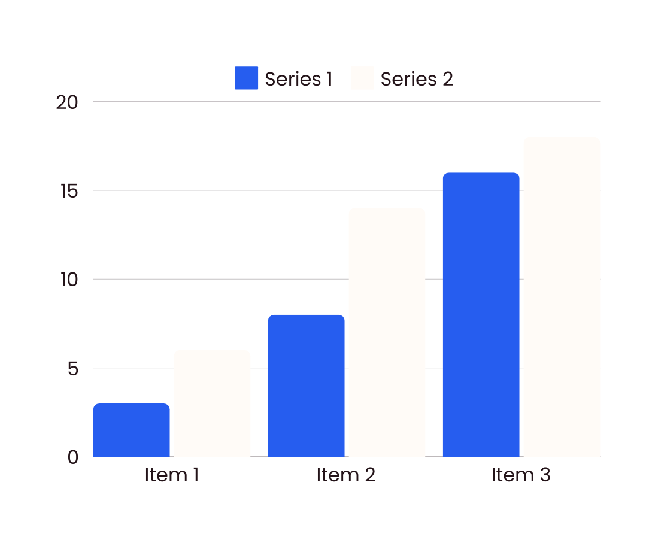
STUDIO SHODWE
HOME
SERVICE
ABOUT US
CONTACT US
FINANCIAL PROJECTIONS
A presentation is a formal talk, often delivered in front of an audience, aimed at conveying information, persuading others, or sharing insights on a particular topic. Presentations can take various forms, such as verbal speeches, slideshows, demonstrations, or multimedia displays.
Operational expenses
Marketing budgets
A presentation is a formal talk, often delivered in front of an audience, aimed at conveying information, persuading others, or sharing insights on a particular topic.
A presentation is a formal talk, often delivered in front of an audience, aimed at conveying information, persuading others, or sharing insights on a particular topic.

Slide 8




STUDIO SHODWE
HOME
SERVICE
ABOUT US
CONTACT US
OUR TEAM
Morgan Maxwell
Olivia Wilson
Neil Tran
Chiaki Sato
Job Title
Job Title
Job Title
Job Title

Slide 9







STUDIO SHODWE
HOME
SERVICE
ABOUT US
CONTACT US
CONTACT US
+123-456-7890
WWW.REALLYGREATSITE.COM
HELLO@REALLYGREATSITE.COM
123 ANYWHERE ST., ANY CITY, ST 12345

Slide 10


STUDIO SHODWE
HOME
SERVICE
ABOUT US
CONTACT US
THANK YOU
FOR YOUR ATTENTION

